Slide 1

Content Strategy Summary
April 2024
Notes:
Dan

Slide 2
Contents
Why have a content strategy? | 3
What’s our content vision? | 6
Where and how we publish content at Oxford | 8
Governance of this content strategy | 18
Q&A and more information | 19

Slide 3





Why do we even need a content strategy?
In 2023, we conducted qualitative and quantitative reviews of digital content across internal and external channels.
This found issues with:
It’s essential we take a more strategic and joined-up approach to content – resolving these issues – so that our investment in platforms in the years ahead delivers an improved experience for users and content creators.
Change is coming – digital transformation programme, including:
    a new web platform by January 2025
    new intranet and email approach for internal digital – with more channels to come
    digital skills and capability strategy
Sites will need to be migrated from the current Mosaic and Oxweb platforms
Content for staff audiences is published on external sites, creating operational risk
Duplicated content and designs = duplicated effort = wasted budget
Recent content audit shows we can do better
Inconsistency
Duplication
Mixed standards
Confusing experience
Opportunity for consolidation

Slide 4
Content strategy sets out vision and standards for Oxford across all digital end points
Building consensus and community for content
Substance
Workflow
What kind of content do we need (topics, types, sources, etc), and what messages does content need to communicate to our audiences?
Substance
What processes, tools, and people/capabilities are required for content initiatives to launch successfully and maintain
ongoing quality?
To bring users the right information, at the right time, in the right format, to fulfil their needs
Structure
Workflow
Structure
Governance
How is content prioritised, organized, formatted, and displayed? (eg communication planning, IA, metadata, data modeling, tagging, linking strategies, etc)
How are key decisions about content and content strategy made? How are changes initiated and communicated?
Governance
Content Components | People Components
© Brain Traffic 2011

Slide 5
Impact of content strategy on key audiences
Taking a strategic, consistent and joined-up approach to content will deliver improvements for content creators, consumers, and the University.
To bring users the right information, at the right time, in the right format, to fulfil their needs
For creators
For users
For the University
Cohesive and unified voice through consistency in tone, UI
Consistency of content quality improving trust and value
Alignment across the digital communication estate for improved audience experience
Ability to learn from peers and apply best practice
Consistency of presentation making content easier to read and use
Change agility so the university can react – as one – to evolving needs
Improved efficiency, reducing time spent on decision-making
Consistency of find and search making content easier to access
Improved efficiency by enabling communicators to focus on value-adding comms
Improved communication outcomes

Slide 6




Our digital communications vision
To create flexible, scalable and secure platforms that are accessible and meet the full range of user needs, and are appropriate to the University’s structure and culture – now and in the future, through:
  Offering consistent, consumer-grade, best-in-class digital communications and digital experiences for all the University’s stakeholders, including staff and students
  Core principles of simplicity, clarity, accessibility and productivity
  Using evidence-based approaches to give every stakeholder the user-focused services and information they need to feel connected, productive, empowered and informed
  Using data to anticipate and predict needs and drive relevance via personalised information and experiences
  Minimising the environmental impact of digital platforms
To bring users the right information, at the right time, in the right format, to fulfil their needs
User centric | Unapologetic focus on meeting user needs at all times
Timely | Content when the user needs it
Accurate | Recognising the importance in providing robust, accurate, valued content, and reviewing it to ensure continued relevance
Courteous to time, device or other limitations | Balancing content provision and the context of readership
Courteous to time, device or other limitations
Balancing content provision and the context of readership

Slide 7
Key principles for content at Oxford
Principle
… which means that
1
Content has a purpose
Content fulfils a specific user need, delivers a clear objective, for a specific audience, with clear action or message
2
Content is world-class
Whether it is succinct, engaging, rich or interactive, content is easy to consume, fit for purpose, consistently designed, and purposeful
3
Content is user-centred
Our audiences may have various needs across the estate – we respect their time and will make it easy for them to achieve their goals
4
Content is unique
Make it easier for users to find and access what they need, and for us to maintain. Keep the websites small and focussed – content should not be duplicated
5
Content has a lifecycle
Content is planned, reviewed, kept up to date or retired when it’s no longer useful
6
Content is measured,
and iterated
We use goals and metrics, user feedback, audits and evidence to help determine what people want and need to know
7
Content is for everyone
Content is jargon-free, accessible, inclusive and on brand. We use the language of our users, so we are useful, relevant and findable. Content meets highest standards of usability and accessibility
Notes:
Liz

Slide 8
Content managed three major architectures: WebCMS, Intranet and Student Hub
External-facing audiences
Staff and students
Oxford Fresco (Web CMS)
Ox-Intranet (Oxford-wide intranet)
A single CMS platform that allows central, division, department and college autonomous publishing under one umbrella
Aggregates content published by teams across Oxford into a single, tailored, user-centric view, using people data
Oxweb on Fresco
University-wide content
Divisions
Departments
Colleges
A unified approach for external content to improve the experience for prospective students and external stakeholders
University-wide content
Communities
Gardens/museums
Student gateway
Academic Divisions
Staff gateway
Colleges
Academic Departments
MyOxford (Student Hub)
Powerful student facing services in one place
Projects
Research
Others
Student content to form part of the intranet experience with signposts back to services on the Student Hub. These two elements could be further integrated in the future to provide a singular student digital experience.
Notes:
JP
So how do we anticipate the content would be organized – the big, ‘what goes where’ question?
Firstly, we’re starting with two broad principles: if we can consolidate to a single web CMS and a single intranet, there are many user, creator and organisation advantages in doing so: users gain from having a single digital experience across their journey on university websites or intranet; creators gain through having deeper readership of their content and having access to wider peer-learning opportunities and the university gains through reduced licensing, support, infosec risks and much more.
The second broad principle is that we recognise subsidiarity and the power of local autonomy to make choices. That means that while we may make recommendations for approaches, we are cognizant that divisions, departments and colleges – indeed, any part of Oxford -- has the freedom to make their own choices. That means that we need to be clear on the benefits of this approach and make the solutions excel.
Externally, we are recommending that the new web CMS is the CMS power behind all external web needs. And for all the reasons just discussed, that the university website is home to information from the university, divisions AND departments. We recommend we retain the staff and student gateways, but that these act as signposts to content and services on the new intranet and the student hub. There’s a well established habit to use the ox.ac.uk website to get to that content that we should utilize.
Colleges, Projects, Research groups, GLAM websites and other Oxford websites should also use the web CMS wherever they can, but we recognise their autonomy. In our work, we learnt that there is good will towards this approach -- and as long as it meets their needs -- they’re amenable to using a single solution.
[CLICK]
On the staff side, we’re aiming towards a one intranet for Oxford approach that will aggregate content and services for the university, divisions, departments AND colleges. Powered by the people data presented earlier, this is a personalised space tailored to the needs and wants of each employee. We also anticipate community spaces allowing for more informal content around shared interest, identity, expertise or to offer support.
Our work suggested that student content could also be part of this intranet experience with the student services remaining part of the student hub. We look forward to exploring this model deeper with Elaine and others in coming months.

Slide 9
Clarity on content location ensuring that content is published in the right place
Staff
Approach services three primary audiences with three platforms:
  Intranet for staff and students
  Hub for dynamic student content
  Website for external audiences
'External' includes a range of stakeholders including prospective staff and students, researchers, research participants etc
For joint audiences, content should be repurposed and written to meet precise needs
Gateways on websites will signpost staff and students to intranet and hub
Information for student offer holders should appear on websites (because they do not have SSO access)
Intranet
Student
External
Websites with links back to intranet
Intranet
Websites
Intranet
Website
Student Hub for Services
Websites

Slide 10
Where to publish – external or internal?
Type of content | Examples | Where to publish
Solely for external audiences | External venue hire information Information for prospective staff and students | Website
Predominantly for external audiences but likely to be of interest to staff and students | Public events to which staff and students are invited External news releases and stories | Full details on website Secondary information on internal channels
Predominantly for staff and students but must be made public for operational or compliance reasons | Contractual information for students How to log on to University networks (eg SSO instructions) Audit-related research and funding content
Predominantly for staff and students, but likely to be of interest to external audiences | Key policies and procedures (particularly those with a significant public interest angle, or which are likely to be subject to freedom of information requests) Winners of internal awards Significant people moves | Full details on internal channels Secondary information on external channels
Solely for internal audiences, with no benefit to making the information public | Internal processes and operational information | Internal channels Light signposting via staff and student gateway if needed
Must not be shared externally for operational, data protection or reputational reasons | Internal security and financial information Personal data about individuals (other than those that need to be contacted by external audiences) | Internal channels Must never be made public
Data classification
Solely for external audiences
External
Internal
Confidential
Solely for internal audiences

Slide 11
Dual publishing guidance
General principles:
Ensure all content is published in context to make it easier for users
Wherever possible, avoid disjointed user journeys across external and internal platforms
Options for sharing internal content with external audiences
Re-purpose external content on website, focused on internal audiences
Use website news stories to share internal news and best practice externally
Share information via other external channels, eg e-newsletters and social media
Options for sharing external content with staff and students
Use a dynamic feed to display external information on the intranet
Provide links from intranet to external content
Re-purpose external content on intranet, focused on internal aspects

Slide 12





Ox-Intranet and Microsoft services
Communicating
All Oxford Staff and Students
(Intranet)
Everyone
Wider groups
[30+ members]
Divisional, Departmental, College
(Intranet, Communities)
Ox-Intranet
Collaborating
My immediate team
[2 - low 10s of staff]
Team collaboration
(MS Teams, SharePoint)
Personal
Personal storage and creation
(Email, OneDrive)
Storing
Notes:
Dan

Slide 13

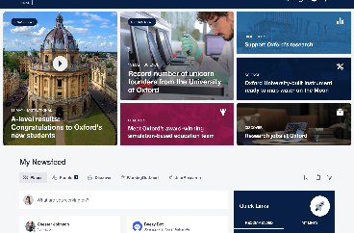

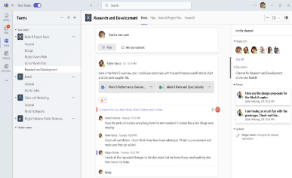
Which internal channel to use
Ox-Intranet
SharePoint and Teams
Canvas
MyOxford
Information for large groups of staff and students
NB: staff services can be linked or embedded into the intranet experience
Information for small groups of colleagues.
Immediate (small) team use:
Materials only relevant for individual teams
Work-in-progress: materials that are in development. (On completion, they may move to the intranet)
SharePoint should no longer be used as an ‘intranet’
Teaching and learning information for students, eg:
Course information
Lecture and reading lists
Dynamic (not static) content, solely for students, eg:
Personal library loans
Upcoming appointments and events
Staff and students
Students only

Slide 14
Where to publish people information
Website
Academic and researcher information (biography / publications)
External-facing professional services staff (eg events / admissions / senior leadership)
Intranet
Information about all staff (academic, technical and professional services)
Student information
(where appropriate)
NB: work is underway to explore automation of academic and research information across web CMS and intranet via Symplectic
Notes:
Liz

Slide 15
Oxford Fresco – standalone site, or OxWeb?
OxWeb on Fresco
Our emerging vision is that the main University website (Oxweb) will be the future home of university-wide content; and that over time it will include divisional and departmental sites, to improve the user journey.
Other Fresco sites
Other entities will continue to run as standalone sites. The content on these sites should follow the content strategy and principles.
Central University content
University-wide content (admissions, research, corporate news, events and information)
UAS content relevant to external audiences
Central services, where there is a commercial or very specific operational need for a standalone website.
Staff and student gateways
Divisional offices
Institutes, schools, and research projects
NB: Decisions to be made on a case-by-case basis about whether these sites are standalone. Consolidation is recommended wherever possible.
Multi-institution collaborations
Divisions and departments
University departments
GLAM
GLAM divisional information
Individual gardens, libraries and museums
Colleges
Conference of Colleges information (TBC)
All college websites
Clubs, societies and subsidiaries
Clubs and society listings
All clubs, societies and subsidiaries
Notes:
Liz

Slide 16
Summary of our content approach
Observation
Reflection
Any content exclusively for staff or students should sit on the intranet and be promoted where appropriate by email
The new Oxford intranet should be the exclusive home for internal content
1
Content for external audiences should be published on the web, supplemented by social channels for amplification
External content should be published via webCMS to a website
2
Any joint audience content needs to consider the primary audience and place accordingly
It is fully appropriate that some audiences have restricted access to some channels and content
3
Content should not repeat or significantly overlap with existing content
Audiences often have access to multiple platforms so where duplication and overlap can reduce confidence in content. Content should be re-written if purpose differs
4
Content should deliver for our content vision
The vision defines our content and should always be central to decision making when publishing
5
Content should always be user-centric
We’ll use data to target content to audiences to improve relevance wherever possible
6
Notes:
SO

Slide 17

How content is initiated, created, published and reviewed at Oxford
Content is initiated by user or business needs and passes content vision test
Plan
Content is reviewed. Content is retained, edited or removed/archived (defined by legal)
Content is drafted
Maintain
Create
Content performance is measured. Does it meet goals? Does it meet content vision?
Measure
Review
Content is reviewed and edited
Publish
Approve
Content is published to intranet, hub or web
Content is signed off by designated approvers in a manual or digital process. Approver must not be the writer and must have the authority to publish

Slide 18
The content strategy will be reviewed by a Community of Practice
To bring key Oxford content stakeholders together, to create consistency in standards and improve our digital experiences.
To share knowledge, be supported and build professionalism in our content across Oxford University
The role
Inform and provide insight for the content strategy
Feed into standards, processes (eg workflow, lifecycle), guidelines, measurement framework
Implement the agreed standards, processes, guidelines, measures in your area
Share learnings from our work with the group – successes and failures
Conduct content crits to improve content standards organisation wide
Learn together – undertake relevant training and development opportunities

Slide 19
The Engagement and Dissemination portfolio will own the content strategy
Steering group oversees the digital transformation of internal and external communication and will be the ultimate owners of the content strategy
A community of practice will be used to maintain the content strategy as the needs of users, creators and the university evolve
 | Engagement and Dissemination portfolio committee
Community of Practice | Transforming Digital Communications Steering Group Chair: David White
 | Web CMS Oversight Group Chair: Liz McCarthy/Shirin Tahzib |  | Intranet Oversight Group Chair: Dan Selinger
 | Web CMS Management | WebCMS & Intranet Co-ordination |  | Intranet Management
Notes:
This is how we 'll manage the project and BAU

Slide 20
Common questions and answers
Will I need to publish my content in different places?
We anticipate there will be a switch from old platforms such as Mosaic and other CMSs to the new platforms. This will start in June 2024 when we will go live with the new intranet. A limited body of internal content – content that that we wish to also share externally – will need to be republished for both intranet and web.
Will I need to use certain content types for our content?
We are planning to use a small number of powerful templates for all our content published internally and externally. By limiting the flexibility, we will improve consistency and advance the user experience of our content across our digital estate
Will I have to set up workflows to assist with content lifecycling?
We will look at automated tools, as part of the content management systems, to assist with content lifecycling. Ensuring that our content is accurate and adds value is central to our platform success
How can I join the Community of Practice to input on content strategy?
A community of practice will be established to input into this content strategy and help refine the details to make sure that it aligns with user and organisational needs. More information about this community will be shared.
4
Where can I get more information?
Please see our web page for more information and updates: https://projects.it.ox.ac.uk/transforming-oxfords-digital-communications-programme-0

Slide 21

Contact
Liz McCarthy, elizabeth.mccarthy@admin.ox.ac.uk
Dan Selinger, dan.selinger@admin.ox.ac.uk

Slide 22
Impact of content strategy on key audiences
V2 without ‘creators’ just in case
Taking a strategic, consistent and joined-up approach to content will deliver improvements for consumers of content and the University.
To bring users the right information, at the right time, in the right format, to fulfil their needs
For users
For the university
Consistency of content quality improving trust and value
Alignment across the digital communication estate for improved audience experience
Consistency of presentation making content easier to read and use
Change agility so the university can react – as one – to evolving needs
Consistency of find and search making content easier to access
Improved efficiency by enabling communicators to focus on value-adding comms
Improved communication outcomes

Slide 23




What does this mean for creators?
Learn and develop
Focus
With a single content strategy for the university, the communication community can learn from each other, developing new ways of working
Coordinating content strategy allows for relentless focus on the communication outcomes
Cohesive approach
Removes complexity
Improved readership of content through harmony of platform and content approach
Simplifies content delivery through agreed standards and approaches
Notes:
Dan

Slide 24


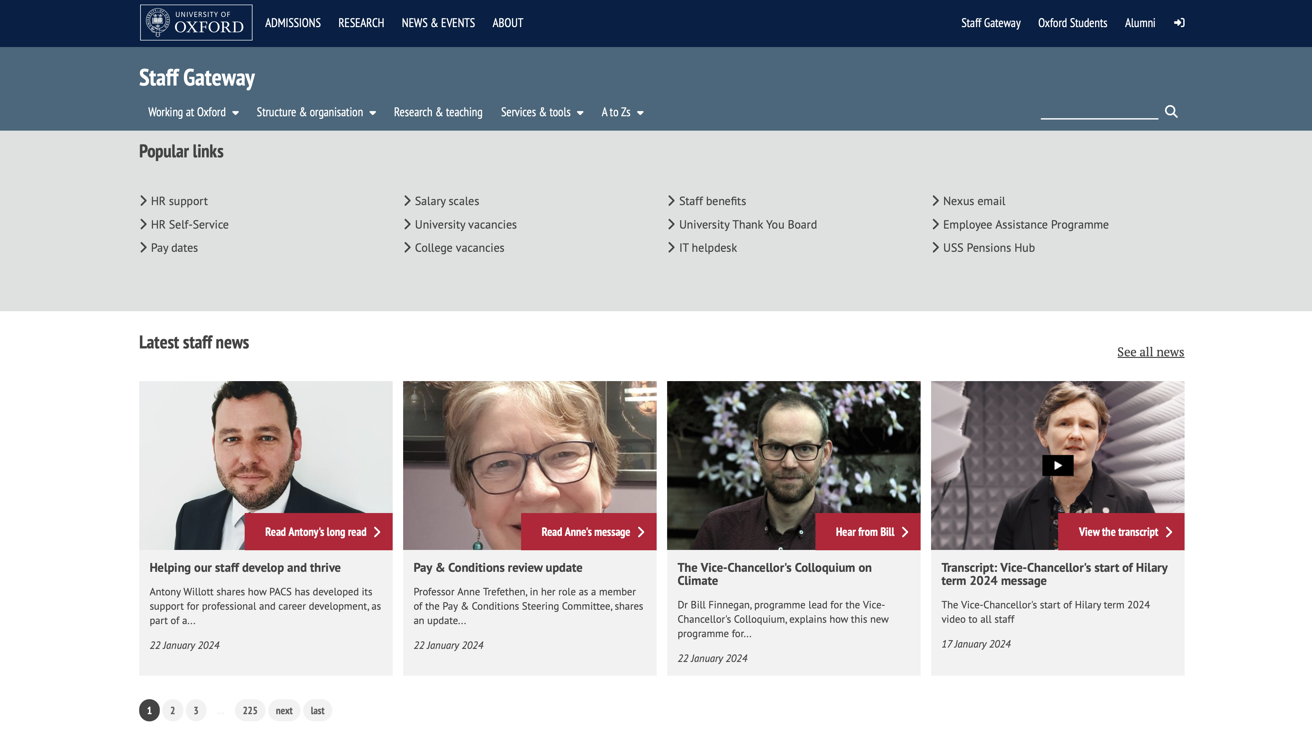
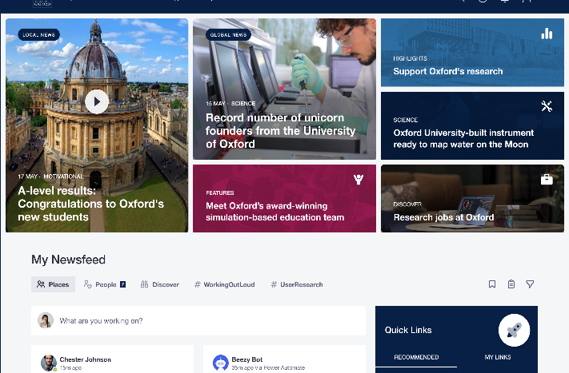
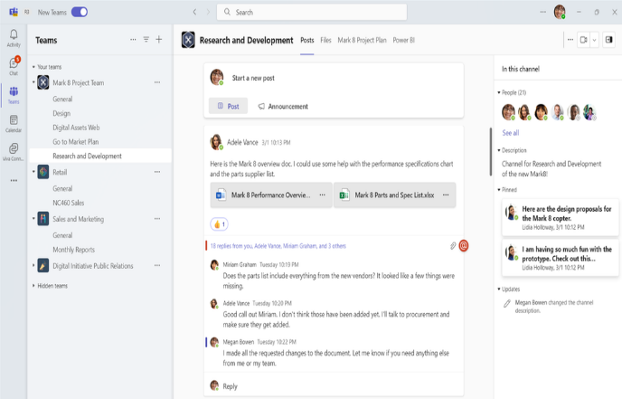

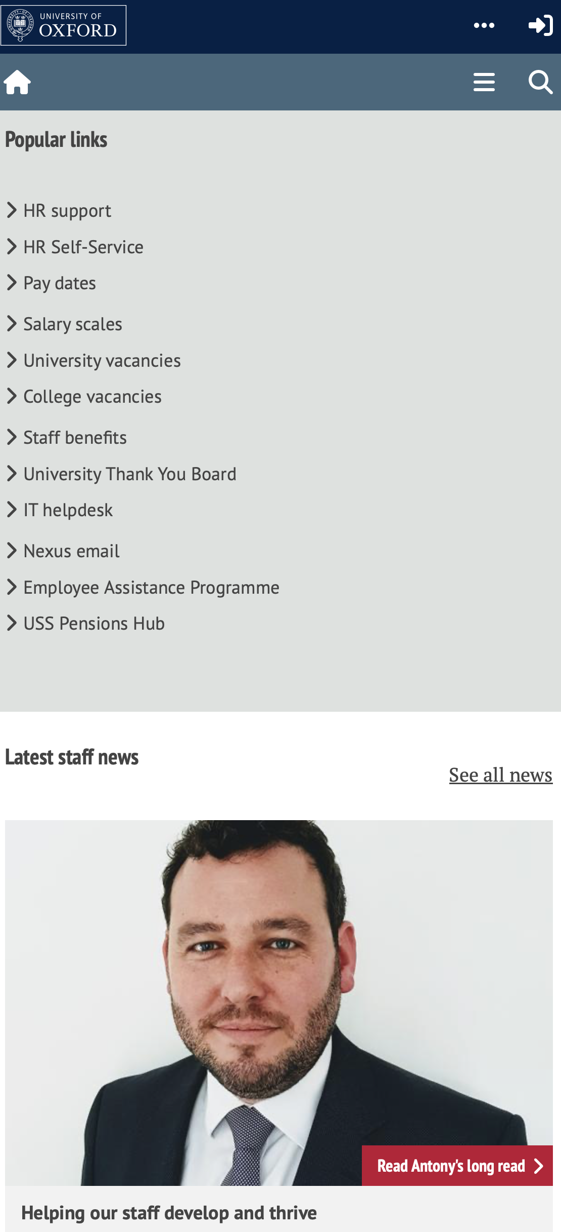
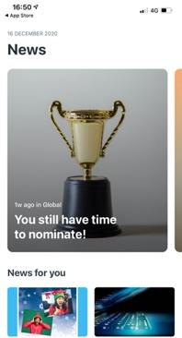
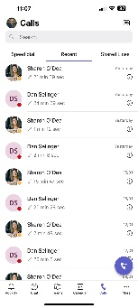
What does this mean for content?
Oxweb
The Intranet
Teams and SharePoint
SSO
Content of value to external audiences is repurposed for Staff Gateway on Oxweb
Content relevant to every staff member or student goes to the intranet
Content for use by small teams, including work-in-progress on Teams and SharePoint
Public and staff content: Materials of value to prospective members of staff or university visitors, re-written and re-published for external use
A signpost to the intranet: A publicly accessible link to the new intranet for additional information and services
A home for all internal content: All staff and staff/student content is published on the intranet
Staff services: Linked or embedded into the intranet experience
Immediate team use: Materials only relevant for individual teams
Work-in-progress: Materials that are in development. On completion, they may move to the intranet
Student services: available on the student hub

